Slide 1
AKASHAY HIRE (A0178512A), APURV GARG (A0178205E), PRADEEP KUMAR (A0163453H), MUNI RANJAN (A0163382E), XIANG XUEMENG (A0178419R), LIANG SHIZE (A0178178M), GENG HUI (A0178516W)
A Novel Audio and Visual Ensemble Approach
for Violence Detection
PRADEEP KUMAR (A0163453H)
MUNI RANJAN (A0163382E)
CHETNA GUPTA (A0178260A)

Slide 2
Problem
130 million surveillance cameras shipped per year – HIS report
In Britain alone, 4.1-5.9 million close circuit television cameras
600,000 cameras in Tianjin produce 50 petabytes of data
Human supervision is almost impossible
Need a highly accurate method to detect violent events (anomalies)
https://towardsdatascience.com/deep-surveillance-6b389abeaf95
Neo

Slide 3
Solution
A novel ensemble technique using Audio & Video datasets proven to be accurate up to 90%
Build classifier for Violence / Non-violence for video events
Build classifier for Violence / Non-violence for audio events
Train Independently
Test & Predict
Neo

Slide 4
Building Blocks
Gunshots, Explosion, Smashing, throwing Stuff, Slap, Kick, talking, laughing, smiling, walking, sports activity, exercise
Deep Learning Video Analytics (3DCNN)
Alert Generator
Visualization
DL Audio Analytics (LSTM)
Geo-Spatial
Visualization
Neo

Slide 5
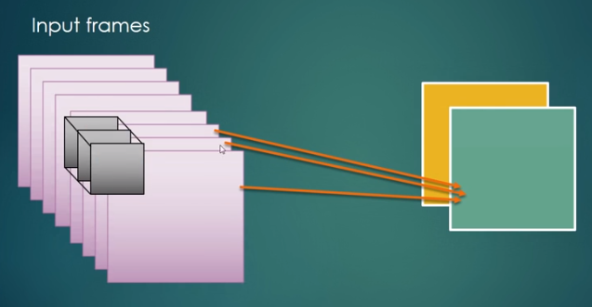
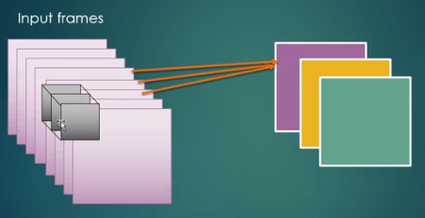
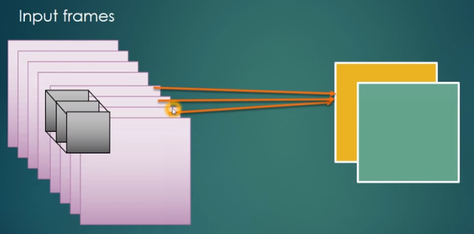
Video Surveillance (3DCNN)
We propose a simple, yet effective approach for spatiotemporal feature learning using deep 3-dimensional convolutional networks. 3D convolutions apply a 3-dimensional filter to the dataset and the filter moves 3-direction (32, 32, 15) to calculate the low-level feature representations. Their output shape is a 3-dimensional volume space such as cube or cuboid. They are helpful in event detection in videos, 3D medical images and so on

Slide 6

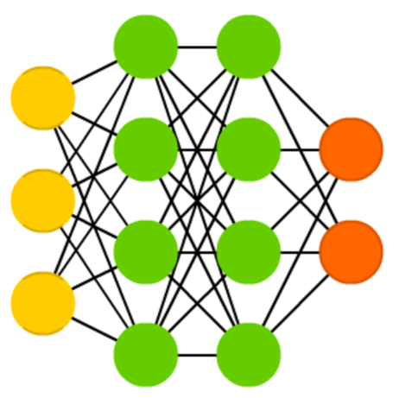


Audio Surveillance (LSTM)
Prediction
Selection
Collected
Possibilities
Forgetting
Memory
Filtered
Possibilities
Ignoring
New Information
Possibilities
Neo

Slide 7
Modelling Approach
The dataset was divided into training and test dataset
Data was tried in different ratios like 80:20
For audio classification, feature Extracted such as MFCC, Chroma, Contrast, Tonnetz, ZCR, STE, Harmonic and Pitch
For video classification, we are using 3D convolutions
LSTM out performed CNN and past machine learning techniques for audio
Neo

Slide 8
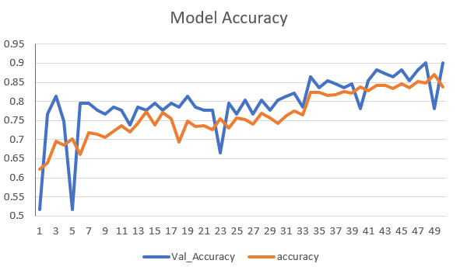

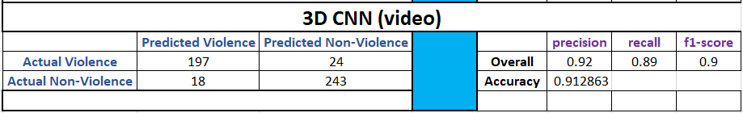
Result Analysis (video)
Neo

Slide 9
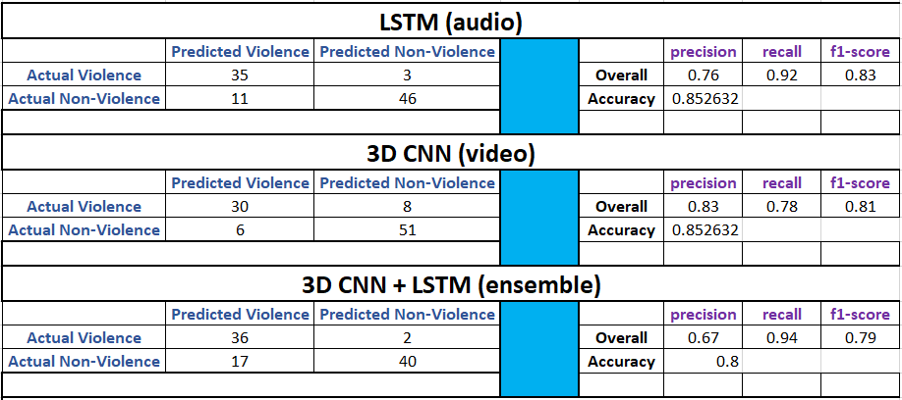
Result Analysis (Ensemble)
We build video model using 3D CNN while audio model using LSTM separately
Out of 95 videos + sound, 38 belonged to violence while 57 belonged to non-violence
Neo

Slide 10
Highlights of ensemble approach
Overall true violence detection rate is high compared to single model
However, overall accuracy goes down due to false negative
Video corresponds to camera positioning while audio to the surroundings
Usage of ensemble technique is not recommended initially due to high false alerts
Needs more data for training so benefits of ensemble can then be fully leveraged at a later stage
Neo

Slide 11
Challenges
Collection of large dataset with violence and non-violence
Challenges in getting video and audio for same dataset
Manual tagging of dataset into violence and non-violence as this is very subjective for different scenarios
Trying out different deep learning models for video and audio
Deep learning models are time consuming on local machines
Trade-off Performance v/s Accuracy v/s Overfitting
Neo

Slide 12
DEMO
Neo

Slide 13

Neo

